Slide 1
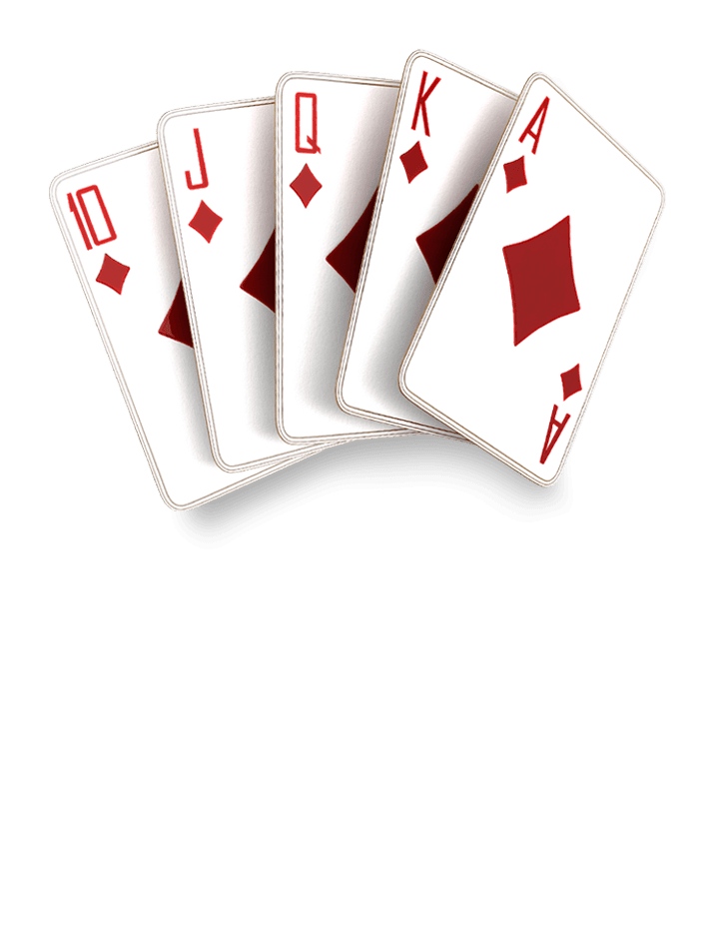
Smith On The River Poker
A poker game that consists of at
least 2 players
Adrianna Barrera
Channing Babb
Khuslen Altangerel
Hadley Bennett
Naya Tan

Slide 2
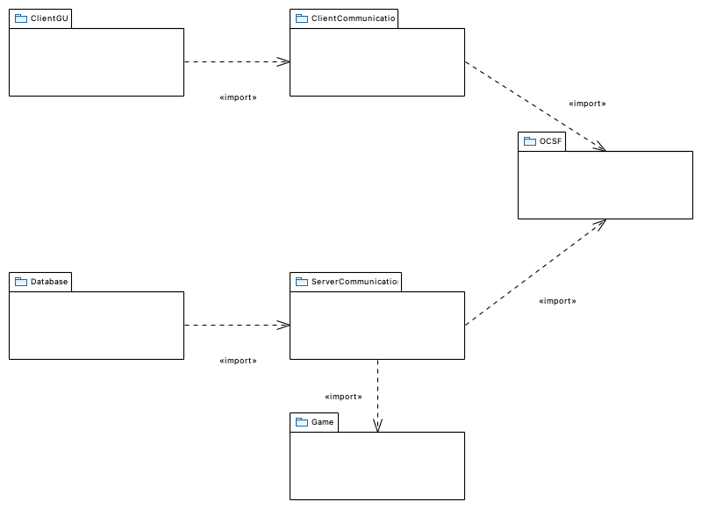
Package Diagram
Adrianna
Hadley
Khuslen
Channing
Naya

Slide 3
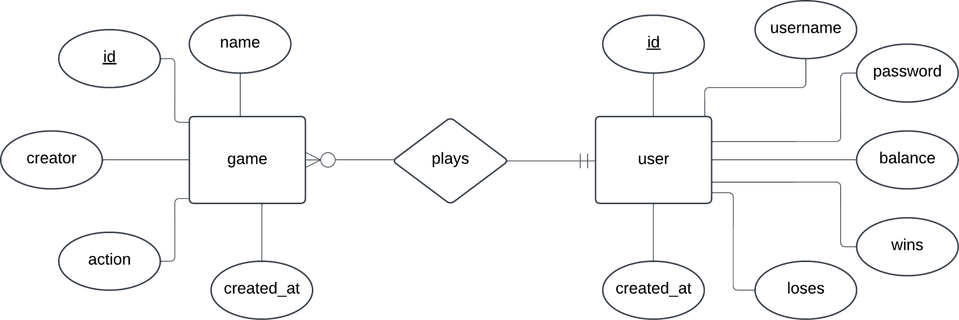
Database Design Diagram

Slide 4
Functional Requirement Example
Player can start game when there are at least 2 players. Buy in fee is automatically taken from each player. The deck is shuffled before the system deals 2 cards to each player. (Start Game)

Slide 5
Use Case Description Example
Use Case: Start Game
Actors: User
User clicks Start Game
System collects buy in fee from each player
System shuffles the deck
System deals two cards to each player
Entry Condition:
Player who created the game clicks “Start Game”
Exit Condition:
The players have their two cards dealt in front of them

Slide 6
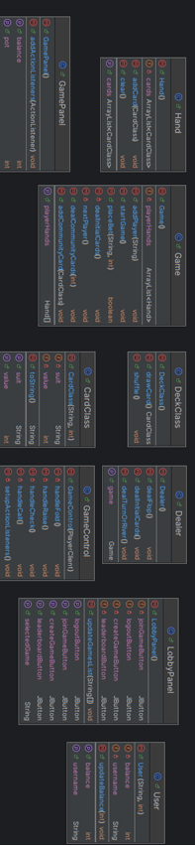
Class Diagram Example
Need to add the class diagram - initial one for use case

Slide 7
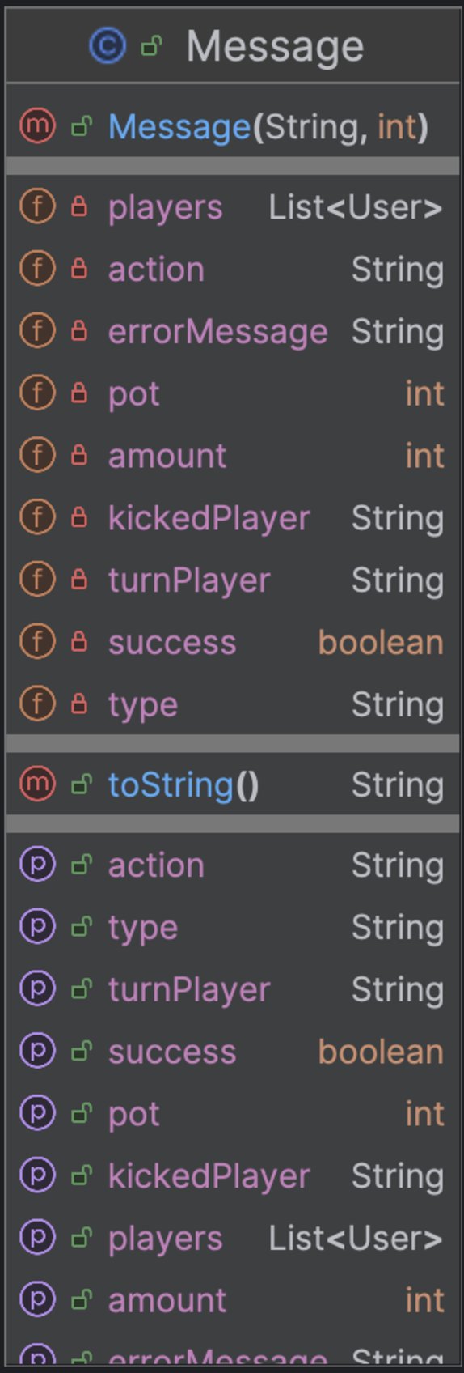
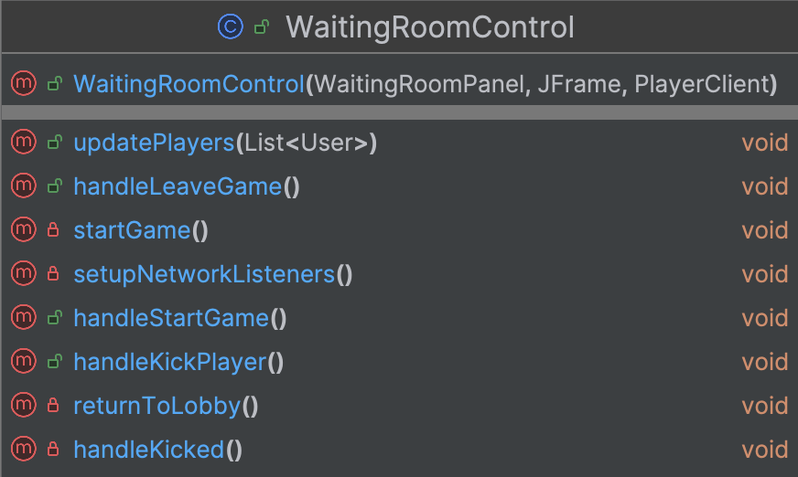
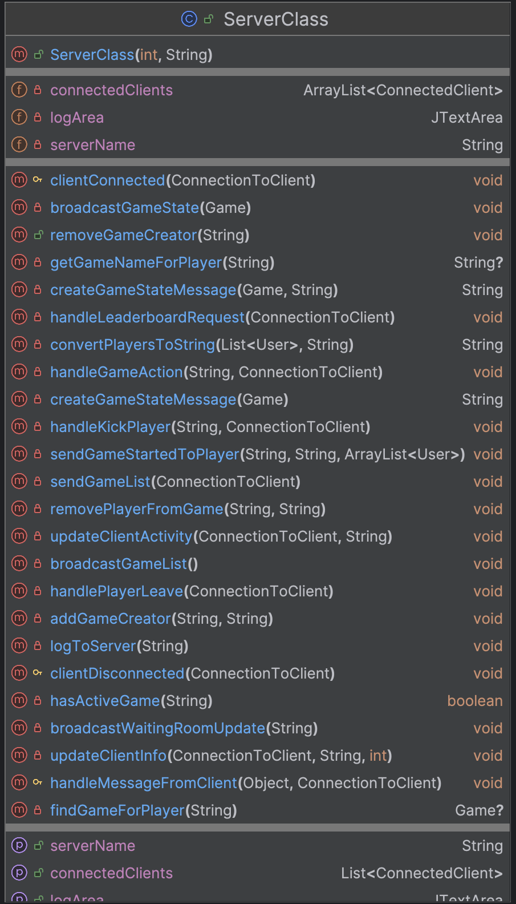
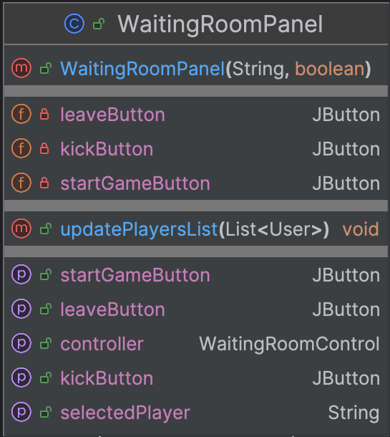
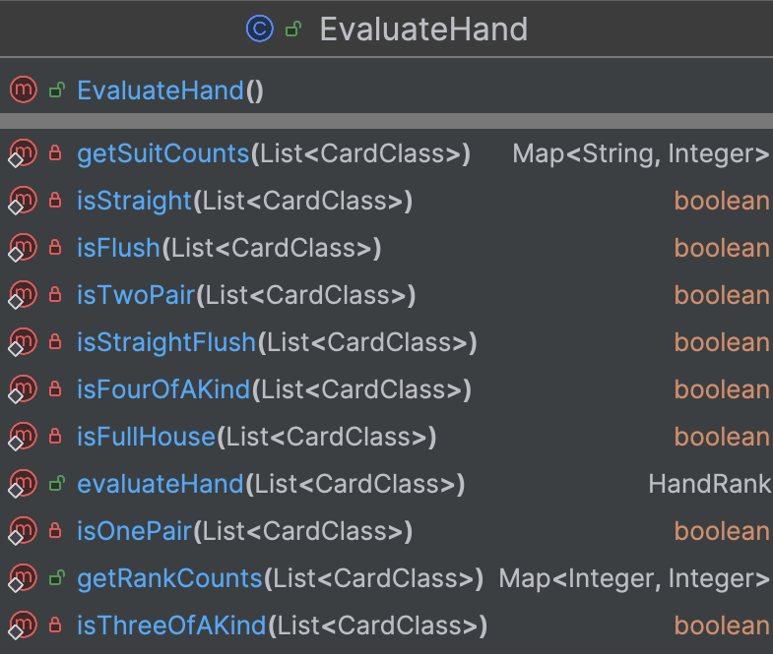
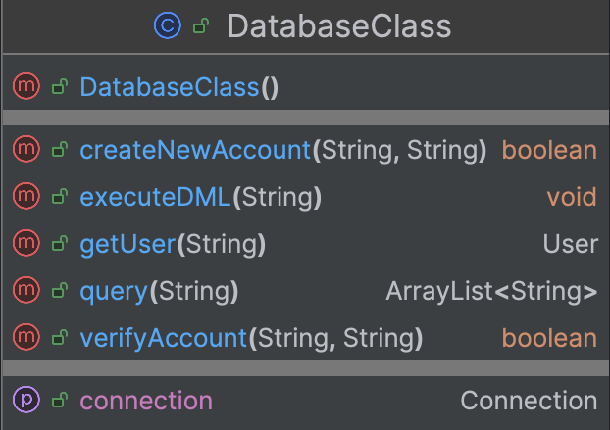
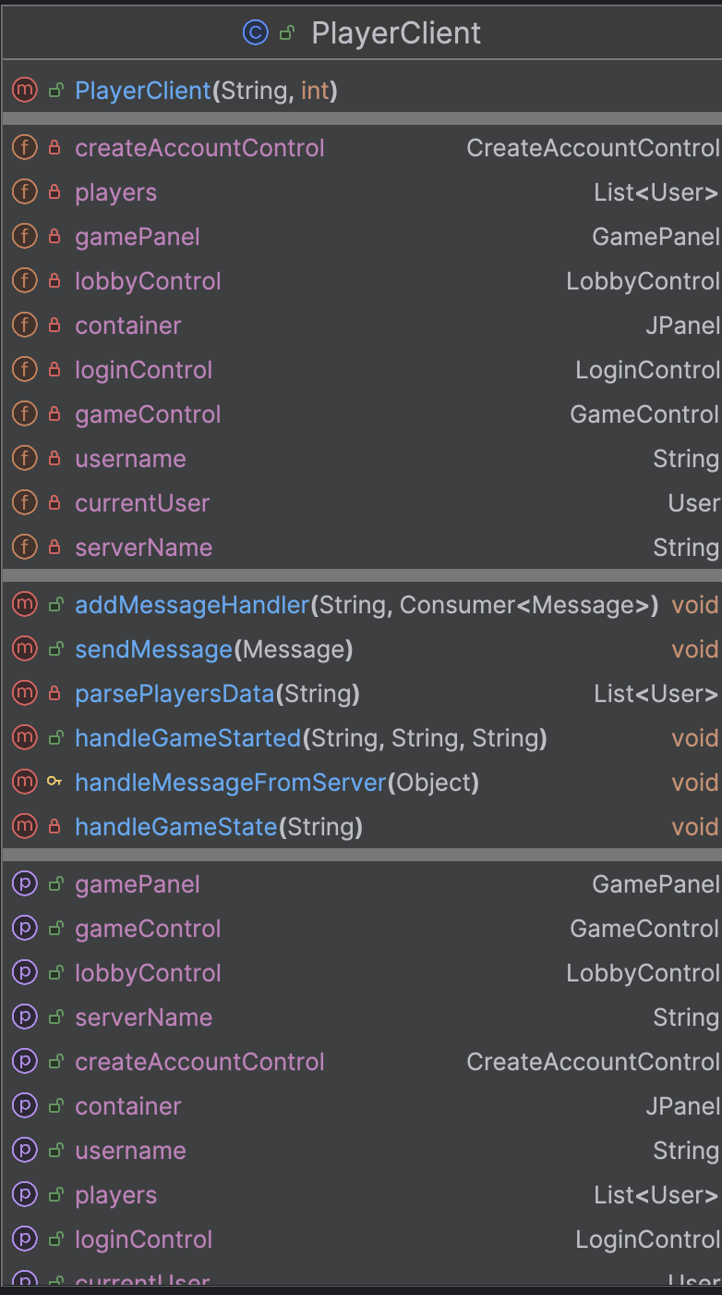
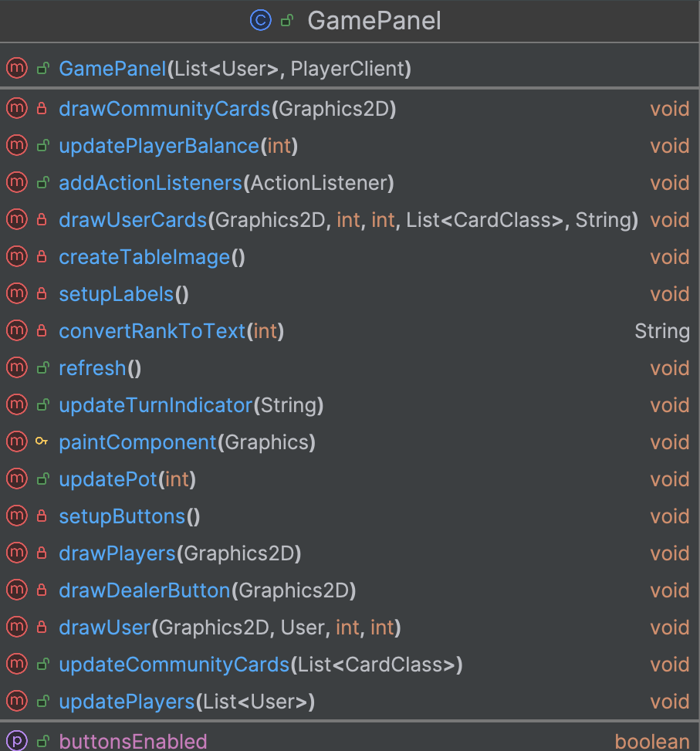
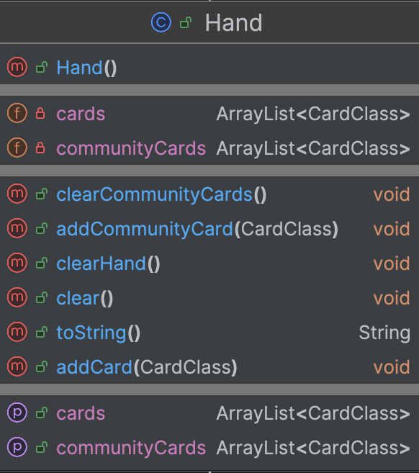
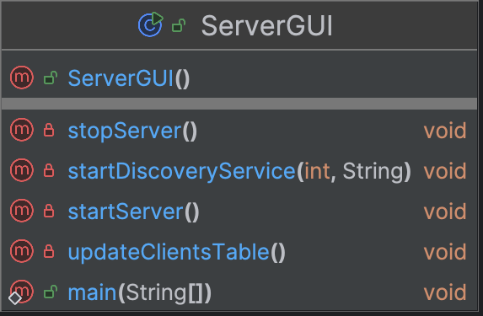
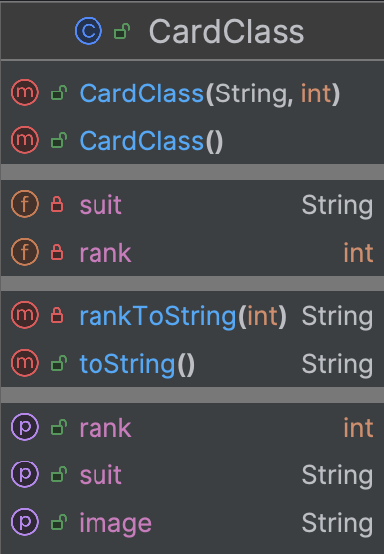
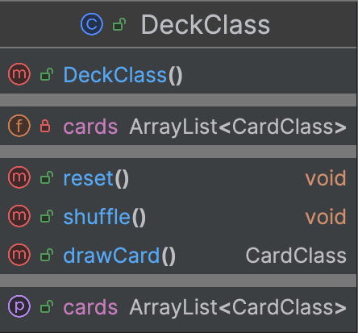
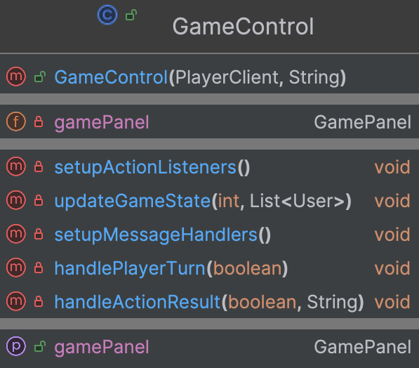
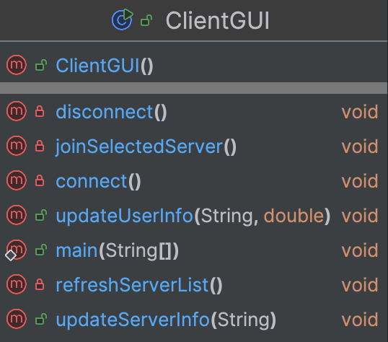
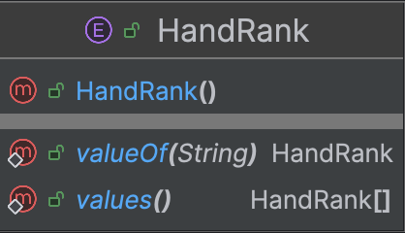
The Final Class Diagram

